Slide 1
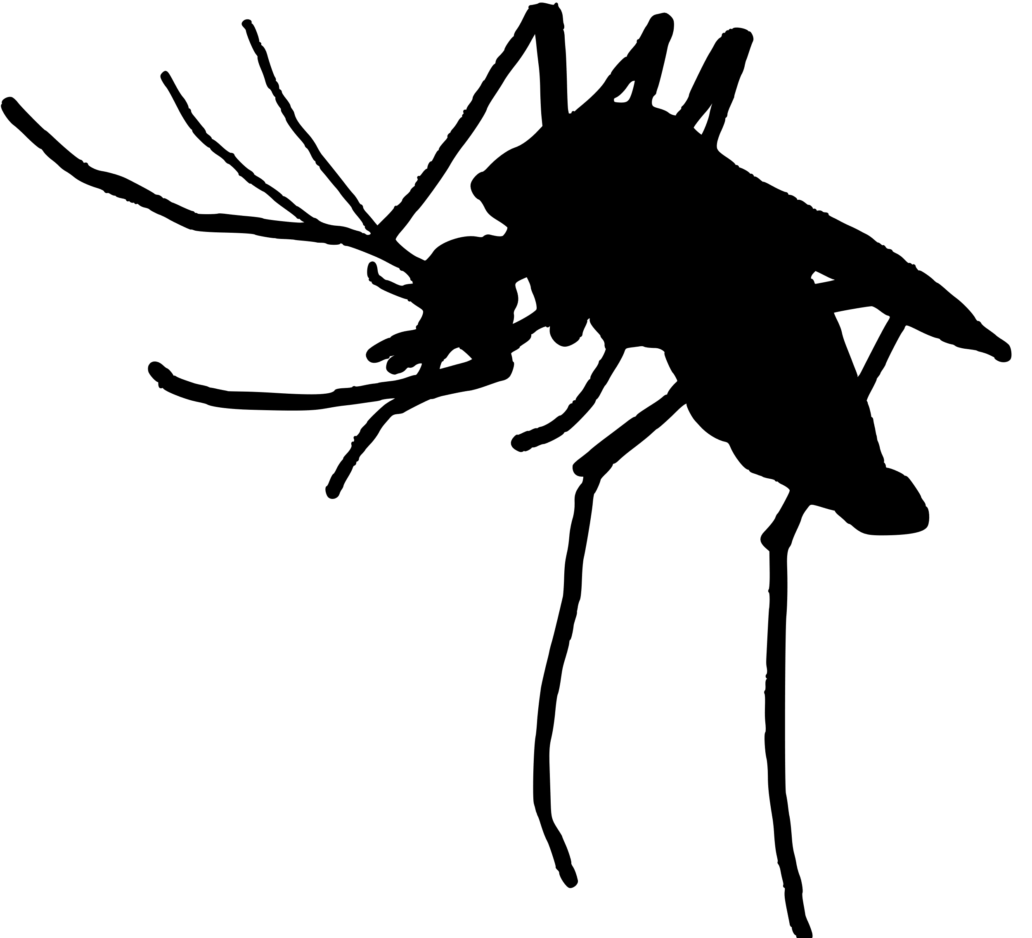
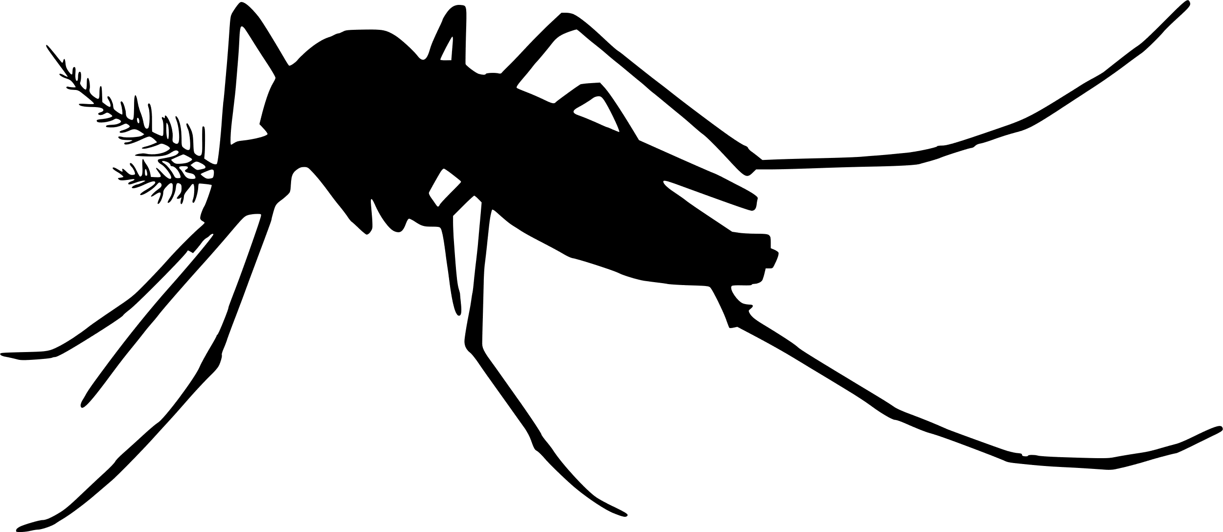
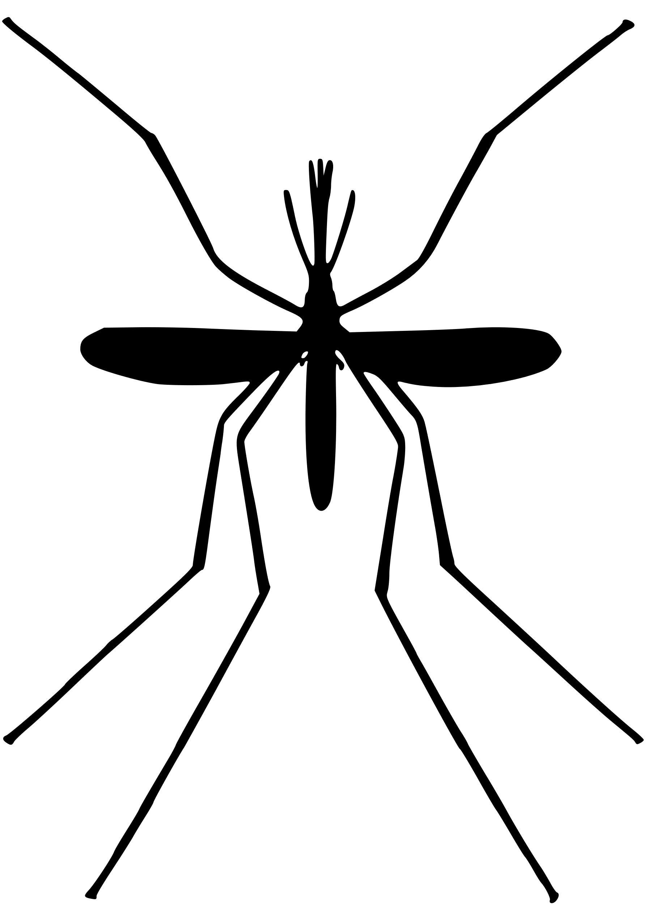

Modeling the mechanisms of mosquito multiple blood-feeding and their effects on disease transmission
Kyle Dahlin, joint with Michael Robert, and Lauren Childs
Virginia Tech, Department of Mathematics
Contact: kyledahlin@vt.edu
ASCEND Fellowship Conference
Nashville, TN

Slide 2
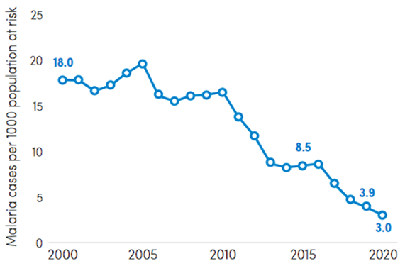
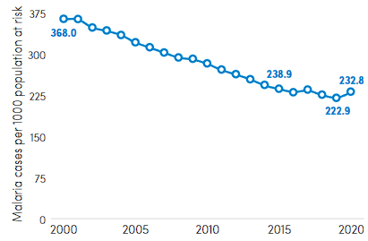
Progress on malaria elimination by 2030 has stalled
South-East Asia region
Africa region
Notes:
> 200 million cases of malaria and up to 400 million cases of dengue
>25% recent emerging infectious disease outbreaks due to MBDs (Jones 2008, Gould 2017)
Malaria has seen a recent uptick in some regions (World Malaria Report 2021)
Predicting MBD outbreaks is complex, needing to account for:
ecology of multiple hosts,
life history of the insect vectors, and
the traits of the pathogens themselves
environmental variables
coinfection
movement
immunology

Slide 3
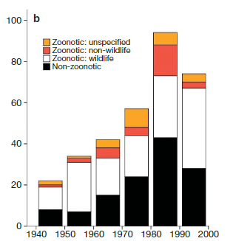
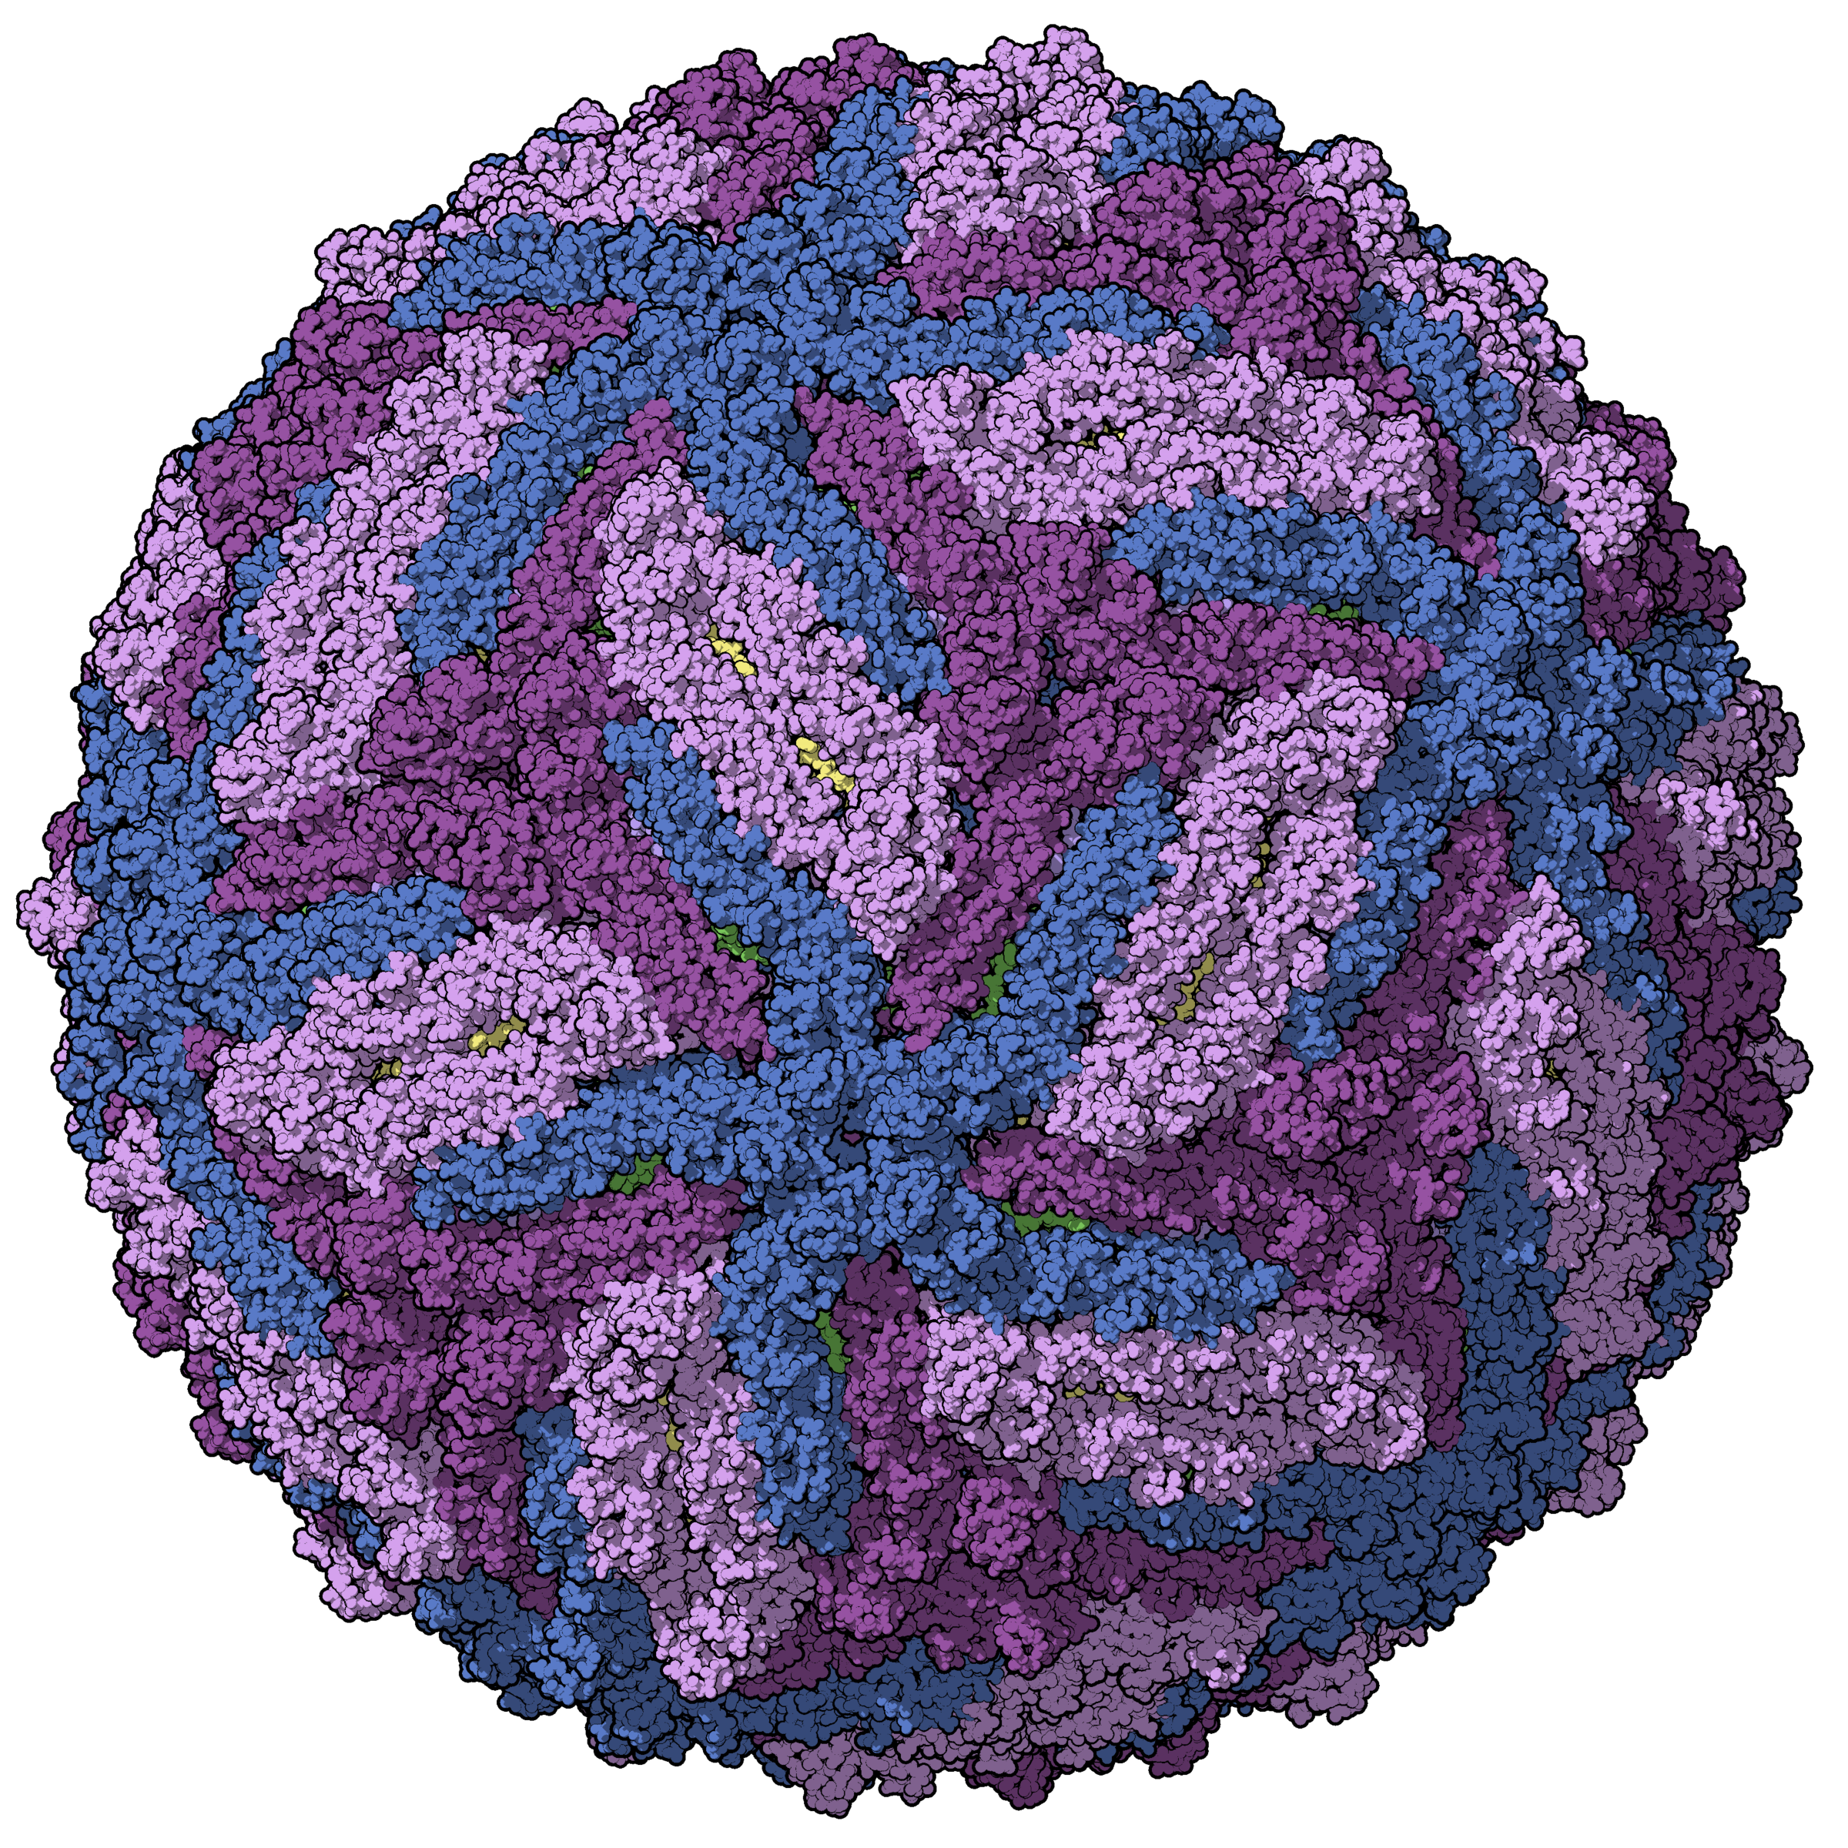
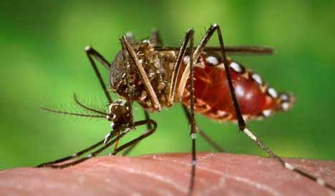
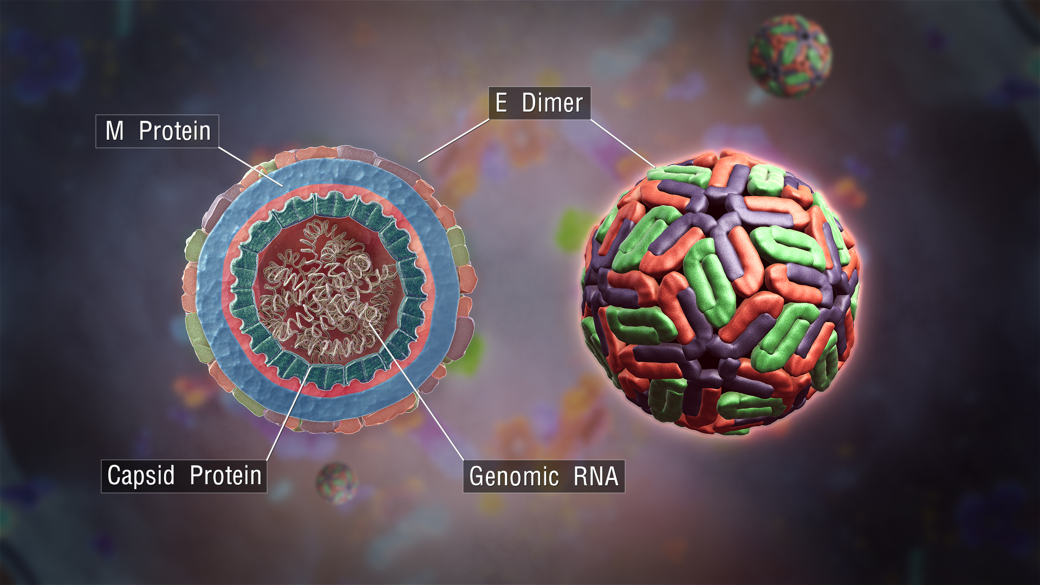
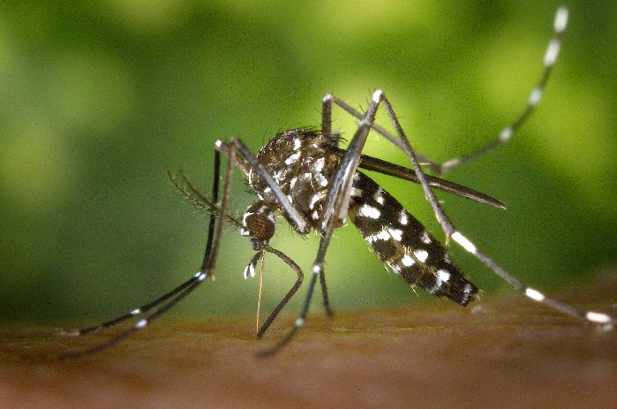
Over 25% of recent emerging infectious disease outbreaks were due to mosquito-borne zoonotic pathogens (Jones 2008, Gould 2017)
Aedes aegypti (CDC.gov)
Zika virus virion
(Manuel Almagro Rivas)
Dengue virus virion (ScientificAnimations.com)
Aedes albopictus (CDC.gov)
Jones, K., Patel, N., Levy, M. et al. Global trends in emerging infectious diseases. Nature 451, 990–993 (2008).
Notes:
Emerging infectious diseases

Slide 4
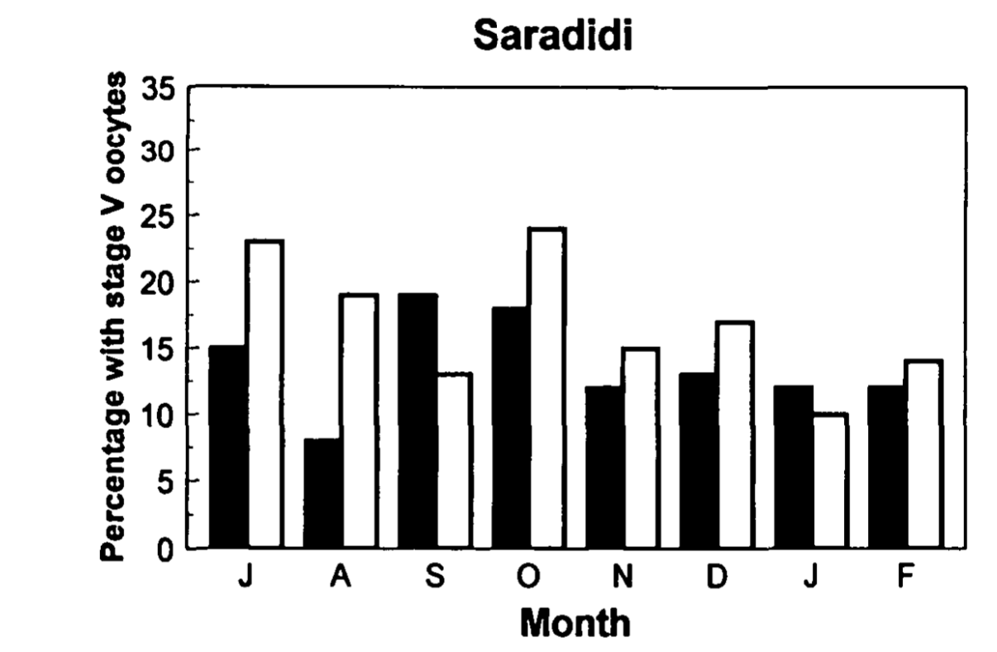
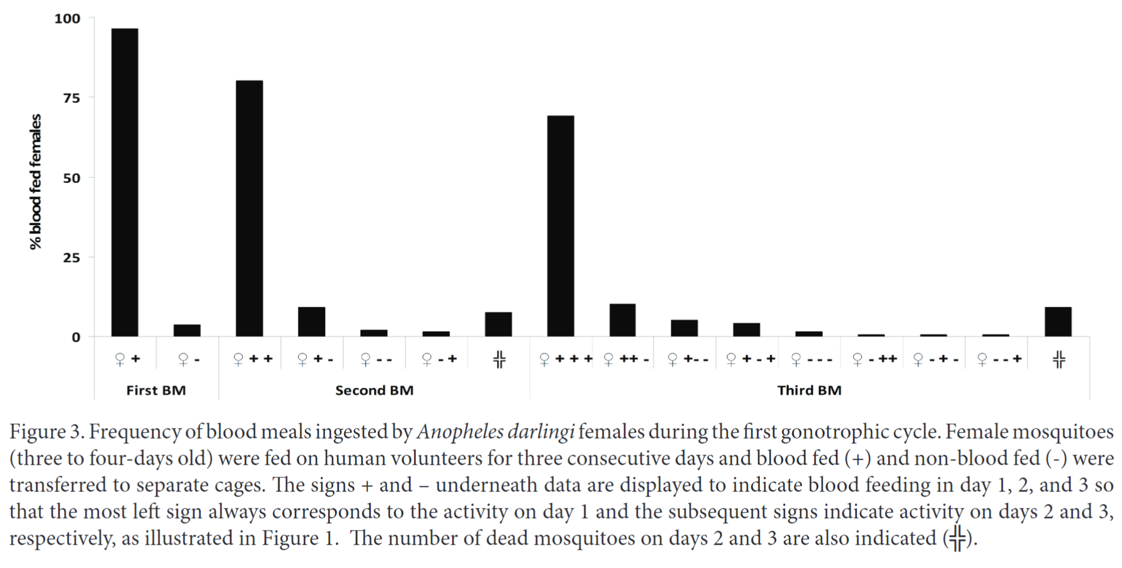
Multiple blood feeding is common
Multiple blood feeding = feeding more than once in a single gonotrophic (reproductive) cycle
1
2
3
1
2
0
0
1
1
2
0
2
1
1
Proportion of Anopheles gambiae and An. Funestus mosquitoes taking an additional blood meal
Modified from Beier (1996) J Med Entomol
Frequency of blood meals ingested by Anopheles darlingi females in a single gonotrophic cycle. Numbers above bars indicate total number of blood meals.
Modified from de Oliveira et al. (2012) J Vector Ecol
Notes:
NB: We use the term “multiple blood feeding” generically to include both interrupted and mixed blood feeding
Particularly true for Anopheles mosquitoes: the primary culprits in transmission of malaria parasites

Slide 5
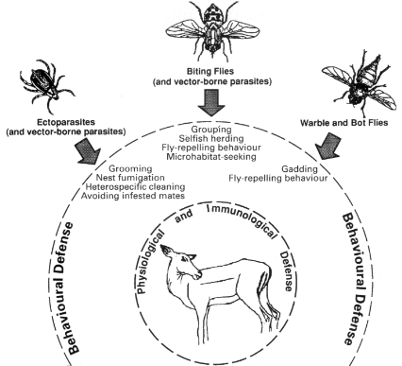
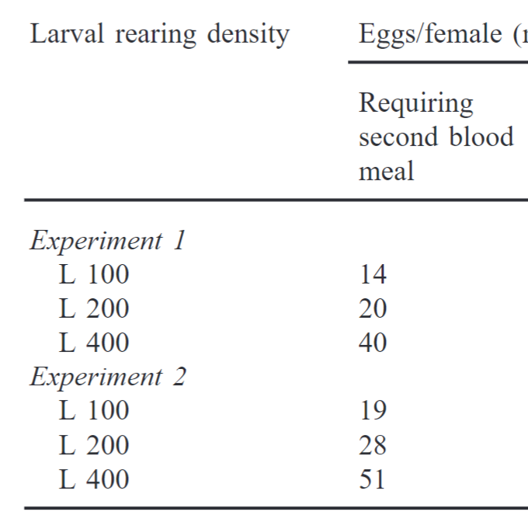
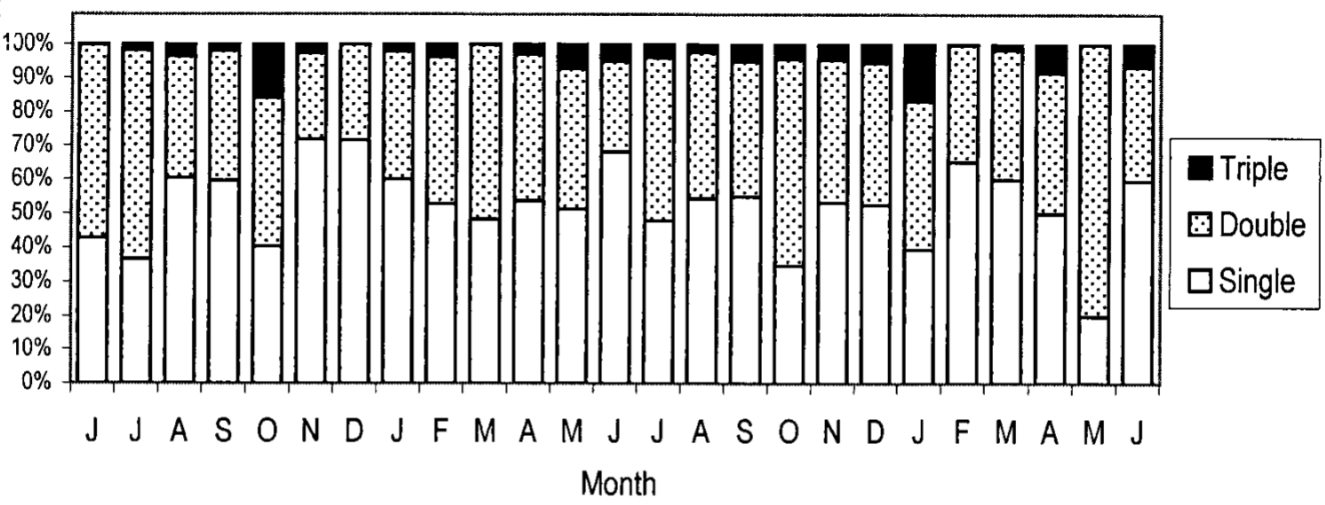
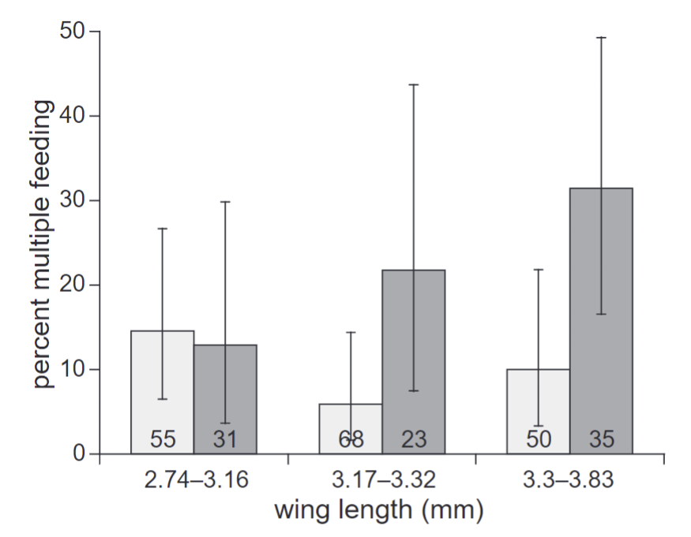
Drivers of multiple blood-feeding
Infection status or
body size
Seasonality
Population density
Uninfected with malaria
Infected with malaria
Seasonality drives patterns in multiple blood feeding for Aedes aegypti
Modified from Scott et al. (2000) J Med Entomol
Effect of size and infection status (Plasmodium falciparum) on the probability of Anopheles gambiae having multiple blood meals
Modified from Koella, et al (1998) Proc Biol Sci
Ramasamy et al. (2000) J Insect Physiol
Hosts have an array of defensive strategies they can employ to avoid insect blood feeding
Hart (1994) Parasitology

Slide 6
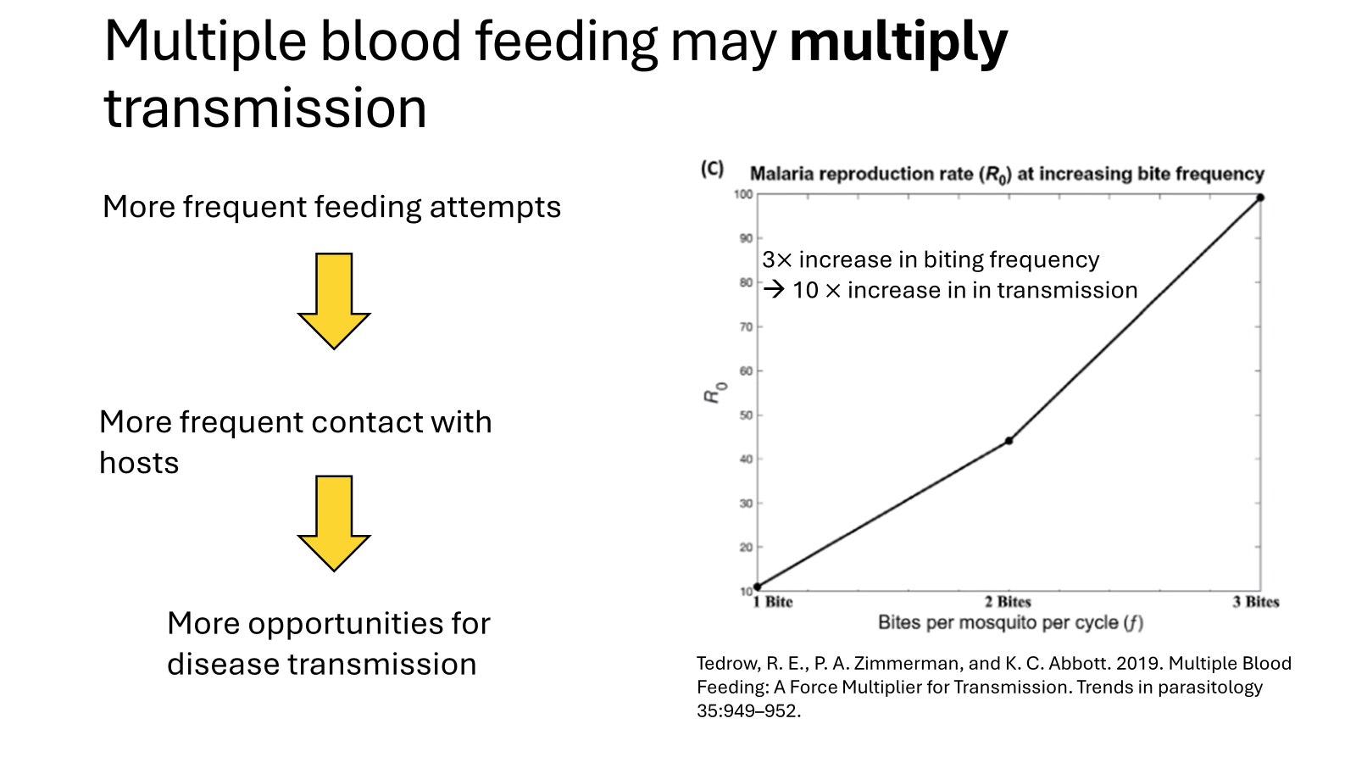

Slide 7

Does multiple blood-feeding always multiply transmission?
Or do the specific mechanisms or drivers matter?

Slide 8
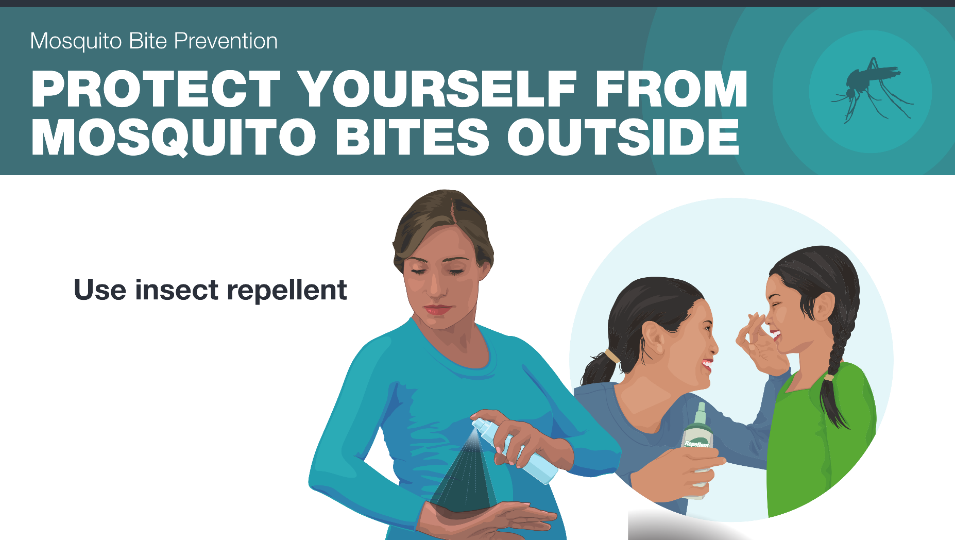
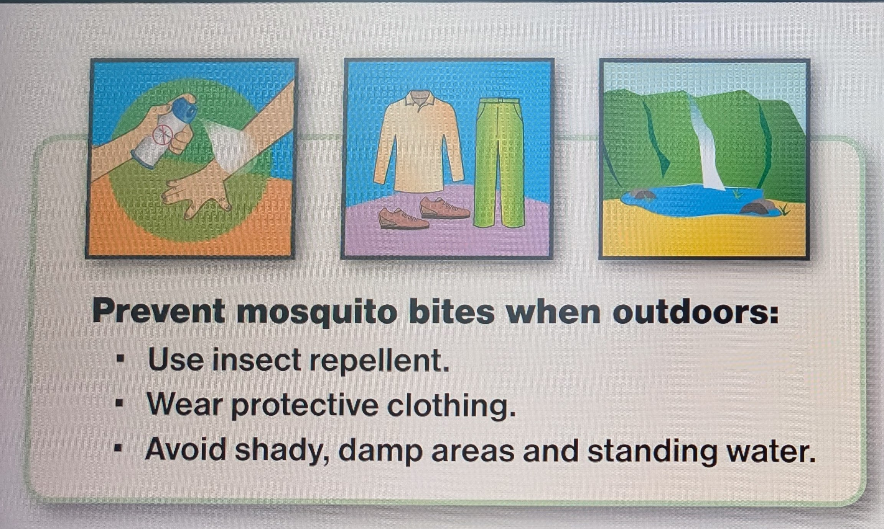

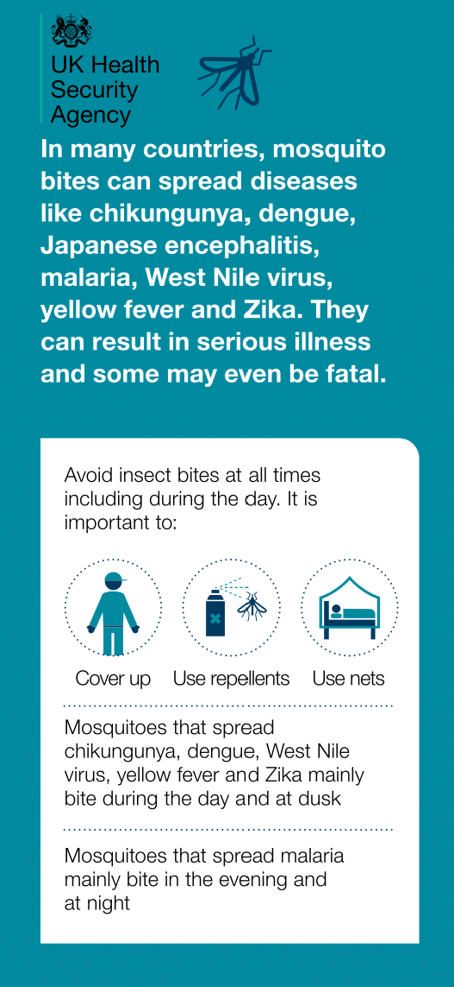

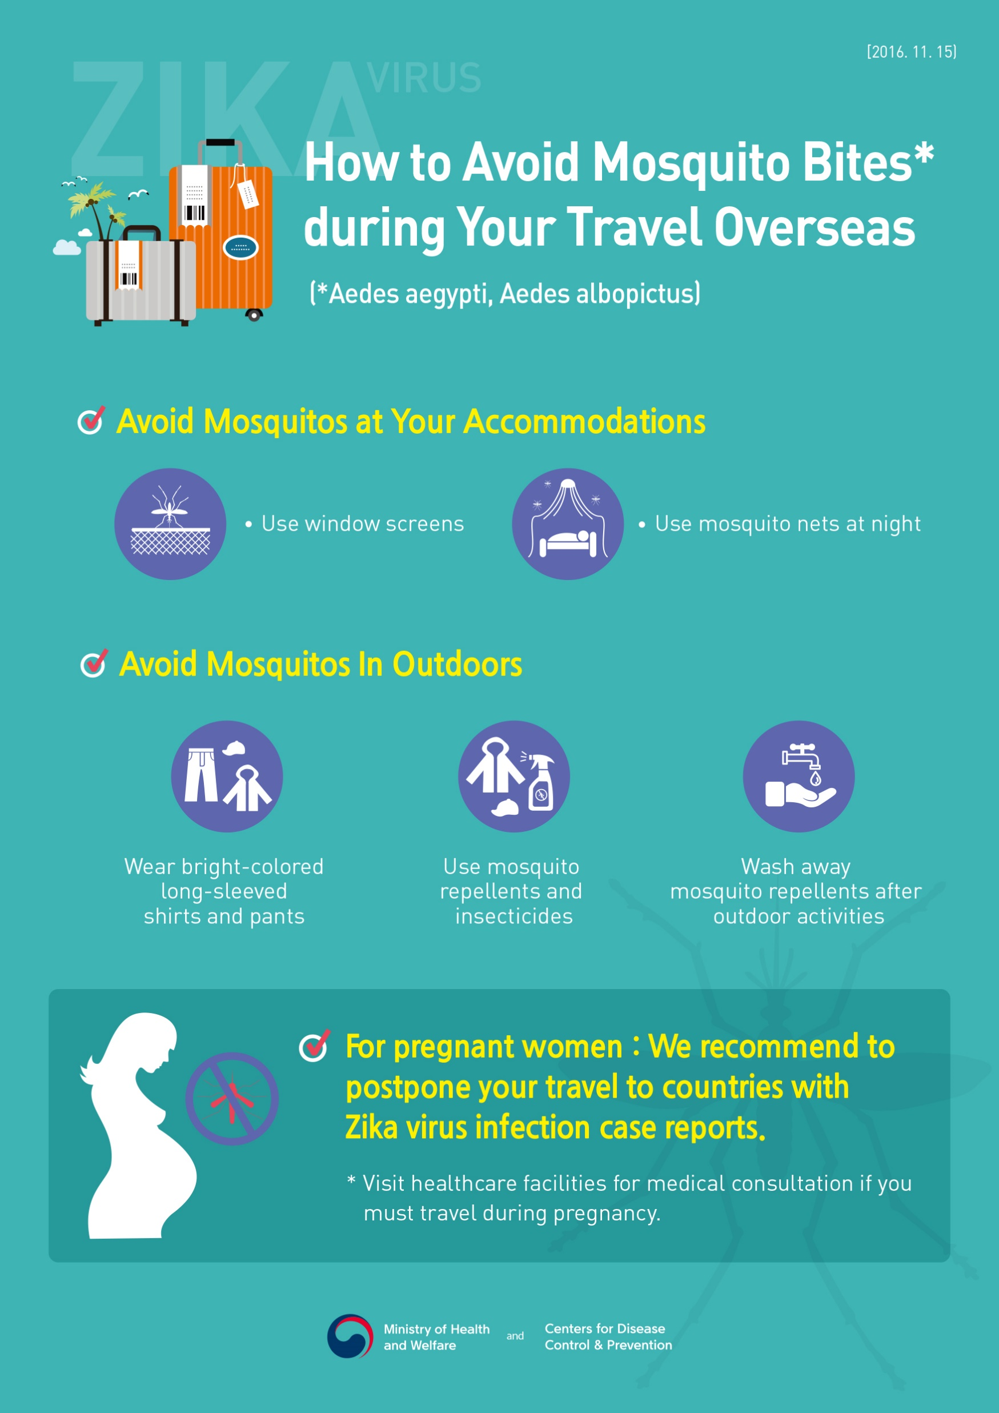
Personal protection measures are commonly recommended for mosquito-borne disease prevention

Slide 9
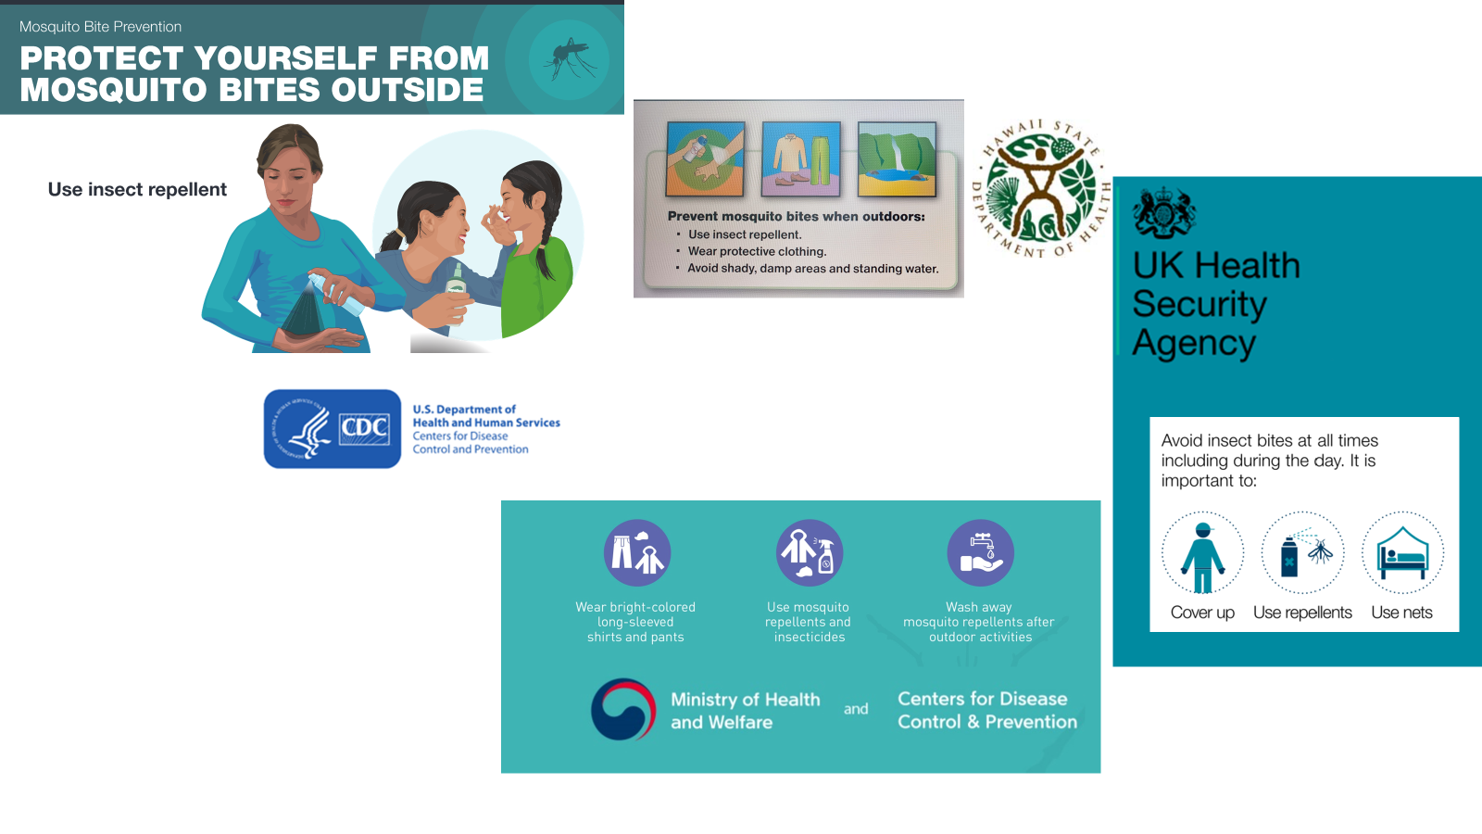
Commonly-recommended personal protective measures
are not included in mosquito-borne disease models.
How might they affect predictions of long term disease spread?

Slide 10
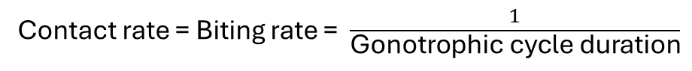
How do we go from this coarse description of mosquito feeding behaviors to a mechanistic model?
The gonotrophic cycle duration – how long it takes a mosquito to go from entering blood-feeding – is the primary data used to parameterize blood-feeding in models
Blood-feeding
Contact rate = Biting rate = $\frac{1}{\text{Gonotrophic} \text{cycle} \text{duration}}$

Slide 11

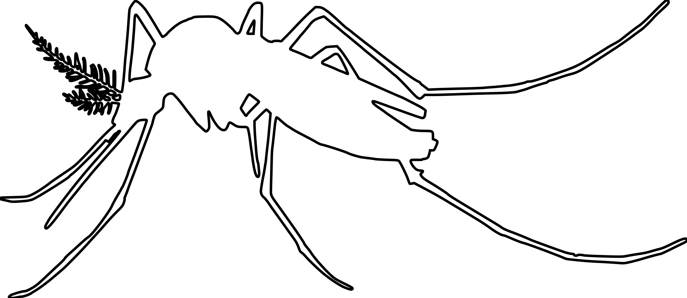
The blood-feeding process
Locate host
“Questing”
“Successful hematophagy culminates in an intricate cascade of events.” – John D. Edman and Andrew Spielman
Landing on host
Probing
Ingesting
Repletion:
Proceed to oviposition stage

Slide 12
The real blood-feeding process
Newly-emerged mosquitoes and those that have recently finished ovipositing
Locate host
“Questing”
Success
Landing
Transmission to host
Probing
Depart and quest for new host
Failure
Ingesting
Transmission to vector
Repletion:
Proceed to oviposition stage
Persist on same host
Notes:
Maybe: combine probing, salivation, and feeding then break them out later when focusing on transmission

Slide 13
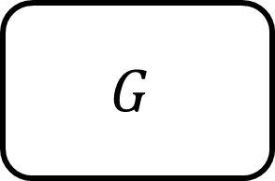
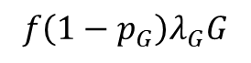
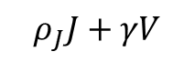
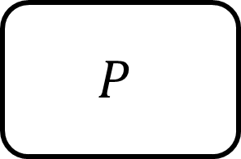
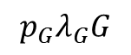
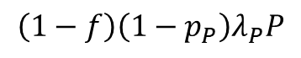
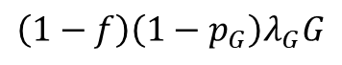
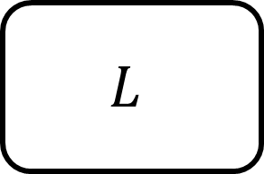
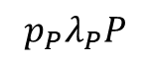

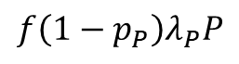
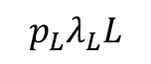
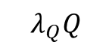
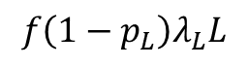
The real blood-feeding process
$$Q$$
$$λ_{Q}Q$$
$$ρ_{J}J+γV$$
Success
$$L$$
$$f\left(1−p_{L}\right)λ_{L}L$$
$$p_{L}λ_{L}L$$
$$P$$
$$\left(1−f\right)\left(1−p_{P}\right)λ_{P}P$$
$$p_{P}λ_{P}P$$
Failure
$$f\left(1−p_{P}\right)λ_{P}P$$
$$G$$
$$p_{G}λ_{G}G$$
$$\left(1−f\right)\left(1−p_{G}\right)λ_{G}G$$
$$f\left(1−p_{G}\right)λ_{G}G$$
Notes:
Maybe: combine probing, salivation, and feeding then break them out later when focusing on transmission

Slide 14
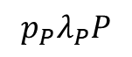
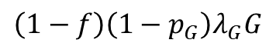
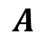

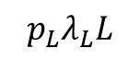
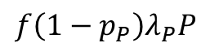
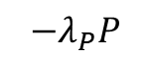
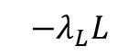
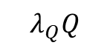
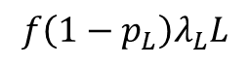
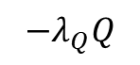
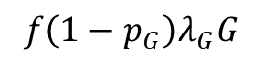
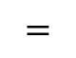
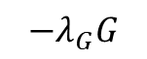

The real blood-feeding process
 |  | $$0$$ | $$0$$
 |  |  | $$0$$
 |  | $$0$$
$$−λ_{Q}Q$$
$$λ_{Q}Q$$
$$f\left(1−p_{L}\right)λ_{L}L$$
$$−λ_{L}L$$
$$p_{L}λ_{L}L$$
$$A$$
$$=$$
$$f\left(1−p_{P}\right)λ_{P}P$$
$$\left(1−f\right)\left(1−p_{P}\right)λ_{P}P$$
$$−λ_{P}P$$
$$p_{P}λ_{P}P$$
$$f\left(1−p_{G}\right)λ_{G}G$$
$$\left(1−f\right)\left(1−p_{G}\right)λ_{G}G$$
$$−λ_{G}G$$
Notes:
Maybe: combine probing, salivation, and feeding then break them out later when focusing on transmission

Slide 15


The real blood-feeding process
$$\frac{d}{dt}\overset{⃑}{B}=\left(ρ_{J}J+γV\right) \overset{⃑}{α}−\left(μI−{ }^{T}\right)\overset{⃑}{B}$$
$$A$$
Notes:
Maybe: combine probing, salivation, and feeding then break them out later when focusing on transmission

Slide 16















Parameter | Description
$$λ_{Q}$$ | Questing | rate
$$f$$ | Seek-new-host | probability
$$p_{L}$$ | Landing | success probability
$$λ_{L}$$ | Landing | exit rate
$$p_{P}$$ | Probing | success probability
$$λ_{P}$$ | Probing | exit rate
$$p_{G}$$ | Ingestion | success probability
$$λ_{G}$$ | Ingestion | exit rate
$$Q$$
Questing
$$ρ_{A}A+γV$$
$$λ_{Q}Q$$
$$L$$
Landing
$$f\left(1−p_{L}\right)λ_{L}L$$
$$p_{L}λ_{L}L$$
$$P$$
Probing
$$\left(1−f\right)\left(1−p_{P}\right)λ_{P}P$$
$$p_{P}λ_{P}P$$
$$f\left(1−p_{P}\right)λ_{P}P$$
$$G$$
Ingesting
$$p_{G}λ_{G}G$$
$$\left(1−f\right)\left(1−p_{G}\right)λ_{G}G$$
$$f\left(1−p_{G}\right)λ_{G}G$$

Slide 17

$\frac{d}{dt}Q=\left(ρ_{A}A+γV\right)+f\left[\left(1−p_{L}\right)λ_{L}L+\left(1−p_{P}\right)λ_{P}P\right]−λ_{Q}Q−μQ$ $\frac{d}{dt}L=$ $λ_{Q}Q+\left(1−f\right)\left[\left(1−p_{L}\right)λ_{L}L+\left(1−p_{P}\right)λ_{P}P+\left(1−p_{G}\right)λ_{G}G\right]−p_{L}λ_{L}L−f\left(1−p_{L}\right)λ_{L}L−μL$ $\frac{d}{dt}P=$ $p_{L}λ_{L}L−f\left(1−p_{P}\right)λ_{P}P−\left(1−f\right)\left(1−p_{P}\right)λ_{P}P−p_{P}λ_{P}P−μP$ $\frac{d}{dt}G=p_{P}λ_{P}P−\left(1−f\right)\left(1−p_{G}\right)λ_{G}G−f\left(1−p_{G}\right)λ_{G}G−p_{G}λ_{G}G−μG$
$$Q$$
Questing
$$ρ_{A}A+γV$$
$$λ_{Q}Q$$
$$L$$
Landing
$$f\left(1−p_{L}\right)λ_{L}L$$
$$p_{L}λ_{L}L$$
$$P$$
Probing
$$\left(1−f\right)\left(1−p_{P}\right)λ_{P}P$$
$$p_{P}λ_{P}P$$
$$f\left(1−p_{P}\right)λ_{P}P$$
$$G$$
Ingesting
$$p_{G}λ_{G}G$$
$$\left(1−f\right)\left(1−p_{G}\right)λ_{G}G$$
$$f\left(1−p_{G}\right)λ_{G}G$$

Slide 18

$$\frac{d}{dt}\left[\begin{matrix}Q \\ L \\ P \\ G\end{matrix}\right]=\left(ρ_{A}A+γV\right)\left[\begin{matrix}1 \\ 0 \\ 0 \\ 0\end{matrix}\right]+\left[\begin{matrix}−λ_{Q} & λ_{Q} & 0 & 0 \\ f\left(1−p_{L}\right)λ_{L} & −λ_{L}+\left(1−f\right)\left(1−p_{L}\right)λ_{L} & p_{L}λ_{L} & 0 \\ f\left(1−p_{P}\right)λ_{P} & \left(1−f\right)\left(1−p_{P}\right)λ_{P} & −λ_{P} & p_{P}λ_{P} \\ f\left(1−p_{G}\right)λ_{G} & \left(1−f\right)\left(1−p_{G}\right)λ_{G} & 0 & λ_{G}\end{matrix}\right]\left[\begin{matrix}Q \\ L \\ P \\ G\end{matrix}\right]−μ\left[\begin{matrix}Q \\ L \\ P \\ G\end{matrix}\right]$$
$$Q$$
Questing
$$ρ_{A}A+γV$$
$$λ_{Q}Q$$
$$L$$
Landing
$$f\left(1−p_{L}\right)λ_{L}L$$
$$p_{L}λ_{L}L$$
$$P$$
Probing
$$\left(1−f\right)\left(1−p_{P}\right)λ_{P}P$$
$$p_{P}λ_{P}P$$
$$f\left(1−p_{P}\right)λ_{P}P$$
$$G$$
Ingesting
$$p_{G}λ_{G}G$$
$$\left(1−f\right)\left(1−p_{G}\right)λ_{G}G$$
$$f\left(1−p_{G}\right)λ_{G}G$$

Slide 19



$$\overset{⃑}{B}=\left[\begin{matrix}Q \\ L \\ P \\ G\end{matrix}\right]$$
$$\frac{d}{dt}\overset{⃑}{B}=\left(ρ_{A}A+γV\right) \overset{⃑}{α}−\left(μI−A^{T}\right)\overset{⃑}{B}$$
$$A^{T}=\left[\begin{matrix}−λ_{Q} & λ_{Q} & 0 & 0 \\ f\left(1−p_{L}\right)λ_{L} & −λ_{L}+\left(1−f\right)\left(1−p_{L}\right)λ_{L} & p_{L}λ_{L} & 0 \\ f\left(1−p_{P}\right)λ_{P} & \left(1−f\right)\left(1−p_{P}\right)λ_{P} & −λ_{P} & p_{P}λ_{P} \\ f\left(1−p_{G}\right)λ_{G} & \left(1−f\right)\left(1−p_{G}\right)λ_{G} & 0 & λ_{G}\end{matrix}\right]$$
$$Q$$
Questing
$$ρ_{A}A+γV$$
$$λ_{Q}Q$$
$$L$$
Landing
$$f\left(1−p_{L}\right)λ_{L}L$$
$$p_{L}λ_{L}L$$
$$P$$
Probing
$$\left(1−f\right)\left(1−p_{P}\right)λ_{P}P$$
$$p_{P}λ_{P}P$$
$$f\left(1−p_{P}\right)λ_{P}P$$
$$G$$
Ingesting
$$p_{G}λ_{G}G$$
$$\left(1−f\right)\left(1−p_{G}\right)λ_{G}G$$
$$f\left(1−p_{G}\right)λ_{G}G$$

Slide 20
















Mechanistic blood-feeding model
$$γ_{R}R$$
$$Q$$
Questing
$$R$$
Resting
$$ρ_{A}A$$
$$λ_{Q}Q$$
$$L$$
Landing
$$f\left(1−p_{L}\right)λ_{L}L$$
$$p_{L}λ_{L}L$$
$$γ_{V}V$$
$$P$$
Probing
$$\left(1−f\right)\left(1−p_{P}\right)λ_{P}P$$
$$p_{P}λ_{P}P$$
$$f\left(1−p_{P}\right)λ_{P}P$$
$$G$$
Ingesting
$$V$$
Egg-laying
$$p_{G}λ_{G}G$$
$$\left(1−f\right)\left(1−p_{G}\right)λ_{G}G$$
$$f\left(1−p_{G}\right)λ_{G}G$$

Slide 21



Standard exponential model
$$bB$$
$$B$$
Blood-feeding
$$ρ_{A}A$$

Slide 22

Mosquito population
Susceptible
Exposed
Infectious
Exposure
Pathogen development
Host population
Recovered
Infected
Susceptible

Slide 23
Mosquito population
Susceptible
Exposed
Infectious
Exposure
Pathogen development
Host population
Recovered
Infected
Susceptible

Slide 24


Theorem: Mosquito population persistence
The mosquito population persists if and only if the basic offspring number, $R$, is greater than one.
Theorem: Disease transmission persistence
Transmission between mosquitoes and hosts persists if and only if the basic reproduction number, $ℛ_{0}$, is greater than one.
$$𝒩$$
Total prob. survive blood-feeding
Total reproduction
Number of oviposition cycles in a lifespan
Notes:
Brief explanation of these quantities in words, not parameters

Slide 25
Parameterized blood-feeding process
Yes = 66%
Questing
No = 34%
Average duration
1/3 days
Seek new host?
Landing
Failure
Success = 70%
10 minutes
Failure
Probing
Success = 80%
5 minutes
Failure
Ingesting
Success = 90%
1 minutes
Oviposition

Slide 26



Comparing mechanistic and standard exponential models
Let $θ$ be the amount of time it takes a mosquito to leave the blood-feeding stages (in reality a random variable)
Using, $\overline{θ}$, the mean waiting time to leave the blood-feeding stage, we can compare the two models
$\overline{θ}$is equivalent to the gonotrophic cycle duration
Exponential | $$\overline{θ}=$$ | $\frac{1}{\text{biting} \text{rate}}$
Mechanistic | $$\overline{θ}=$$ | $${\overset{⃑}{1}}^{T}{\left(−A\right)}^{−1}\overset{⃑}{α}$$
For now, we will vary two unknown parameters:
$f =$ the probability of seeking a new host after being disrupted
$\frac{1}{λ_{Q}}=$ the average duration of the questing stage
Notes:
Fixing $θ$ does not uniquely determine the mechanistic parameters
$θ$ is linear in $f$ and the inverses of the other parameters

Slide 27

Distribution of blood-feeding stage duration, $θ$
Notes:
Largely overlap, some difference at very low durations (~10 minutes) where exponential has most density

Slide 28

To most efficiently reduce R₀ ,
increase questing duration or make landings less successful

Slide 29
Failing more frequently at the ingestion stage increases R₀

Slide 30
Surprisingly, seeking a new host more frequently also reduces R₀

Slide 31
Effective personal protection measures should:
decrease the ability of mosquitoes to locate a host, or
decrease the ability of mosquitoes to land on a host, or
cause mosquitoes to flee upon disruption
while also not disrupting mosquitoes while they are ingesting blood, as this “restarts” the blood-feeding process

Slide 32





“Smell bad but taste delicious”

Slide 33


Developed a tractable, mechanistic model of mosquito blood-feeding behavior integrating the phenomenon of multiple blood-feeding via disruption
This model can be directly compared to standard models through the gonotrophic cycle duration or blood-feeding stage duration parameter

Slide 34

Misidentification of the mechanism of multiple blood-feeding can lead to a misestimation of R₀
Preliminary recommendations for personal protection measures:
These should reduce
rate at which mosquitoes locate humans
probability that mosquitoes land on humans
Bonus points if it does not interrupt ingestion
*Priorities might shift due to other population-level interventions

Slide 35




Thank you!
Joint work with colleagues at Virginia Tech:
Lauren M. Childs
Michael Robert
Contact: kyledahlin@vt.edu
@kjmd.bsky.social
https://sites.google.com/view/kyledahlin
This work supported by NSF DMS Award # 2316455

Slide 36
Parameter name | Value | Type
Mosquito lifespan | 20 days | Mosquito life history trait
Oviposition & resting period | 2 days | Mosquito life history trait
Eggs per female per day | 3 eggs per day | Mosquito life history trait
Larval development period | 12 days | Mosquito life history trait
Larvae survival probability | 62.5% | Mosquito life history trait
Larvae carrying capacity | 3000 individuals | Mosquito life history trait
Extrinsic incubation period | 6 days | Parasite trait
Host-to-vector transmission probability | 100% | Parasite trait
Vector-to-host transmission probability | 100% | Parasite trait
Host infectious period | 7 days | Parasite trait
Host lifespan | 65 years | Host life history trait
Host carrying capacity | 10^7 individuals | Host life history trait
Notes:
Table of baseline parameter values

Slide 37
Parameter name | Type | Value
Questing rate | Blood-feeding | 1/(480 minutes)
Seek-new-host probability | Blood-feeding | 66%
Landing success probability | Blood-feeding | 70%
Exit rate from landing stage | Blood-feeding | 1/(10 minutes)
Probing success probability | Blood-feeding | 80%
Exit rate from probing stage | Blood-feeding | 1/(5 minutes)
Ingestion success probability | Blood-feeding | 90%
Exit rate from ingestion stage | Blood-feeding | 1/(1 minutes)
Mosquito mortality rate | Mosquito life history trait | 1/(20 days)
Exit rate from oviposition & resting | Mosquito life history trait | 1/(2 days)
Average # eggs per female per day | Mosquito life history trait | 3
Larval development rate | Mosquito life history trait | 1/(12 days)
Larvae survival probability | Mosquito life history trait | 62.5%
Larvae carrying capacity | Mosquito life history trait | 3000
Extrinsic incubation rate | Parasite trait | 1/(6 days)
Host-to-vector transmission prob. | Parasite trait | 100%
Vector-to-host transmission prob. | Parasite trait | 100%
Host infectious period | Parasite trait | 7 days
Host mortality rate | Host life history trait | 1/(65 years)
Host carrying capacity | Host life history trait | 10^7 individuals
Notes:
Table of baseline parameter values

Slide 38

$ℛ_{0}=$Pr(host infection)
$×$ Contact rate to host
$×$ Total probability of surviving the extrinsic incubation period
$×$ Average # blood-feeds with undeveloped infection
$×$ Vector infectious period
$×$ Average # blood-feeds
$×$ Host infectious period
$×$ Pr(vector infection)
$×$ Contact rate to vector
$×$ Vector-host population ratio

Slide 39

The response of the basic reproduction number (R₀) and
basic offspring number (R) to blood-feeding parameters is largely similar
Notes:
Basic offspring number and basic reproduction number as functions of blood-feeding parameters

Slide 40

Transmission is optimized when mosquitoes fail often at feeding while
the mosquito population is maximized when feeding is always successful
Notes:
Zoom in on ingesting probability

Slide 41

How dependent are these priorities on
other traits of the mosquito or the parasite?

Slide 42

The length of the extrinsic incubation period doesn’t affect intervention priorities
Notes:
Parasite traits perhaps are not too important in terms of targeting blood-feeding
Surprising!

Slide 43

Shortening the resting period increases the importance of probing probability

Slide 44

Drastic reductions in mosquito lifespan shift priorities substantially

